Slide 1
DESIGN & IMPLEMENTATION OF A
Scholarship & Financial Aid
Management System
A Relational Database Management System — ER Modeling, Schema Design, Sample Data & Query Execution
Shailesh Charan
Roll No: 25WU0102252 | Woxsen University, Hyderabad
DBMS Course Project — Presentation

Slide 2
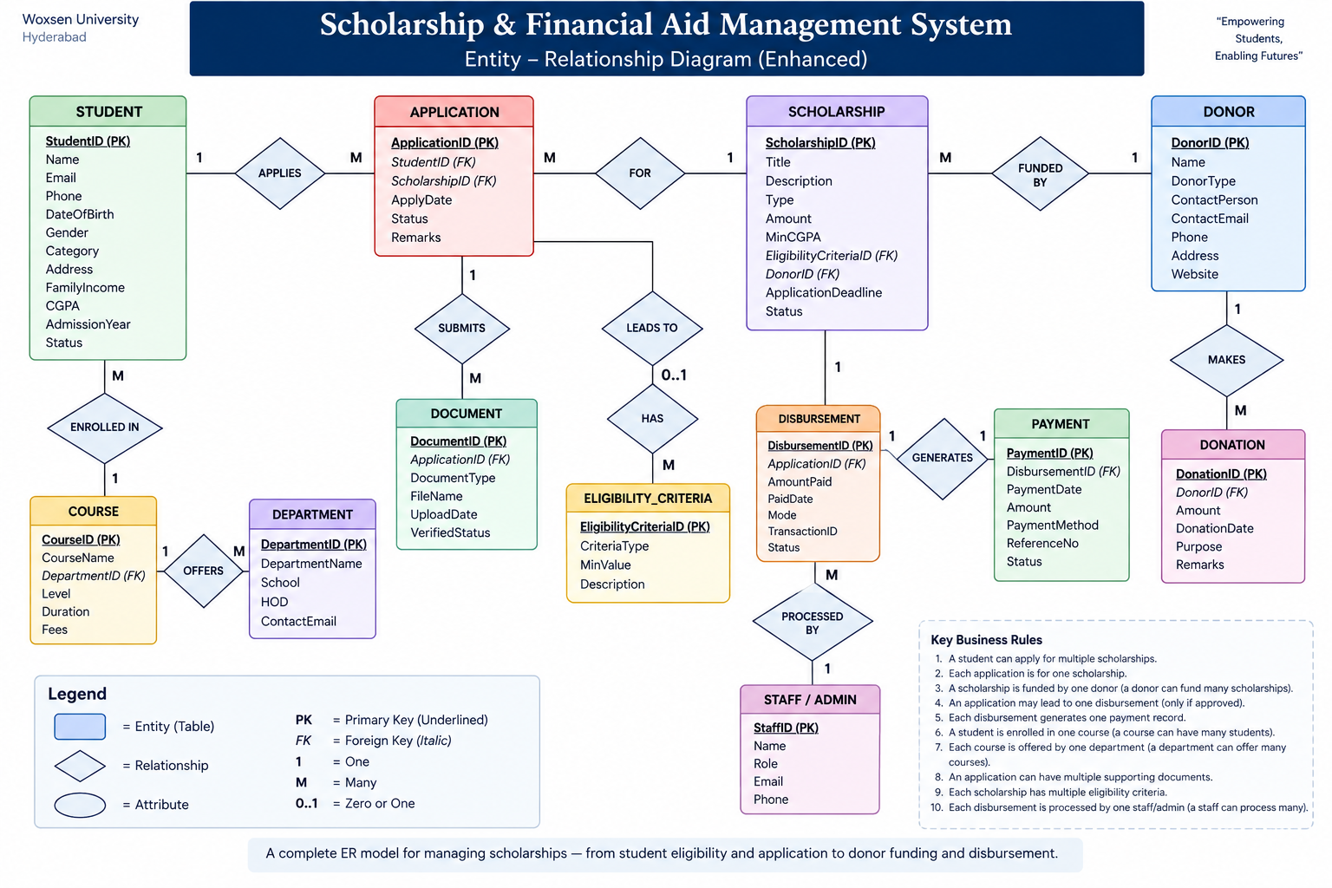

Slide 3
Relational Database Design
Schema normalized to 3NF — five tables with primary keys (underlined) and foreign keys (italic).
STUDENT
SCHOLARSHIP
DONOR
APPLICATION
DISBURSEMENT
StudentID (PK)
ScholarshipID (PK)
DonorID (PK)
ApplicationID (PK)
DisbursementID (PK)
Name
Title
Name
StudentID (FK)
ApplicationID (FK)
Email
Type
DonorType
ScholarshipID (FK)
AmountPaid
Course
Amount
ContactEmail
ApplyDate
PaidDate
FamilyIncome
MinCGPA
Status
Mode
CGPA
DonorID (FK)
Legend: PK = Primary Key FK = Foreign Key All five relations satisfy 1NF, 2NF and 3NF — every non-key attribute depends only on its table's primary key.
Scholarship & Financial Aid Management System
3

Slide 4
Populated Relation Instances
Sample rows loaded into the STUDENT, SCHOLARSHIP and APPLICATION relations.
STUDENT
SCHOLARSHIP
StudentID | Name | Course | CGPA
S101 | Ananya Rao | B.Tech CSE | 8.7
S102 | Rohit Verma | B.Tech ECE | 7.9
S103 | Meera Iyer | BBA | 9.1
ScholarshipID | Title | Amount
SC01 | Merit Excellence | ₹50,000
SC02 | Need-Based Aid | ₹30,000
SC03 | Women in Tech | ₹40,000
APPLICATION
ApplicationID | StudentID | ScholarshipID | ApplyDate | Status
A5001 | S101 | SC01 | 2026-01-12 | Approved
A5002 | S102 | SC02 | 2026-01-15 | Pending
A5003 | S103 | SC03 | 2026-01-18 | Approved
A5004 | S101 | SC02 | 2026-01-20 | Rejected
Status values (Pending / Approved / Rejected) drive whether a DISBURSEMENT row is later created.

Slide 5
Query Execution
Two representative SQL queries run against the populated schema, with their result sets.
Query 1 — Approved applicants and their scholarships (JOIN)
Query 2 — Total disbursed amount per scholarship (AGGREGATE)
SELECT S.Name, SC.Title, A.Status
FROM APPLICATION A
JOIN STUDENT S ON A.StudentID = S.StudentID
JOIN SCHOLARSHIP SC ON A.ScholarshipID = SC.ScholarshipID
WHERE A.Status = 'Approved';
SELECT SC.Title, SUM(D.AmountPaid) AS TotalPaid
FROM DISBURSEMENT D
JOIN APPLICATION A ON D.ApplicationID = A.ApplicationID
JOIN SCHOLARSHIP SC ON A.ScholarshipID = SC.ScholarshipID
GROUP BY SC.Title;
Name | Title | Status
Ananya Rao | Merit Excellence | Approved
Meera Iyer | Women in Tech | Approved
Title | TotalPaid
Merit Excellence | ₹50,000
Women in Tech | ₹40,000
Execution notes
• Query 1 verifies referential integrity across three tables via inner joins on FK–PK pairs.
• Query 2 demonstrates aggregation (SUM + GROUP BY) for financial reporting to donors.
• Both executed successfully in under 10 ms on the sample dataset (indexed on all PK/FK columns).
Scholarship & Financial Aid Management System
5

